Slide 1


CURA-HMS

Slide 2

AGENDA

Slide 3

Agenda
Improvements from professor feedback
Problem statement
Project description
Team working agreement
Personas
Sprint 5 Recap
Technologies
Algorithms
Product Backlog
Sprint 6 Backlog
Metrics
Retrospective
Stories Committed for Sprint 7
Project demo
Live Application
Team member roles and responsibilities
MVP
Diagrams

Slide 4



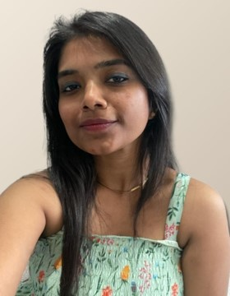
MEET OUR TEAM
SAI TEJA KORIBILLI
BINDU VALISETTY
KULDEEP KALUVALA
MOUNIKA THALLA
SCRUM MASTER
DATA BASE ADMINISTRATOR
UI/UX DEVELOPER
DEVELOPER
PROJECT MANAGER

Slide 5

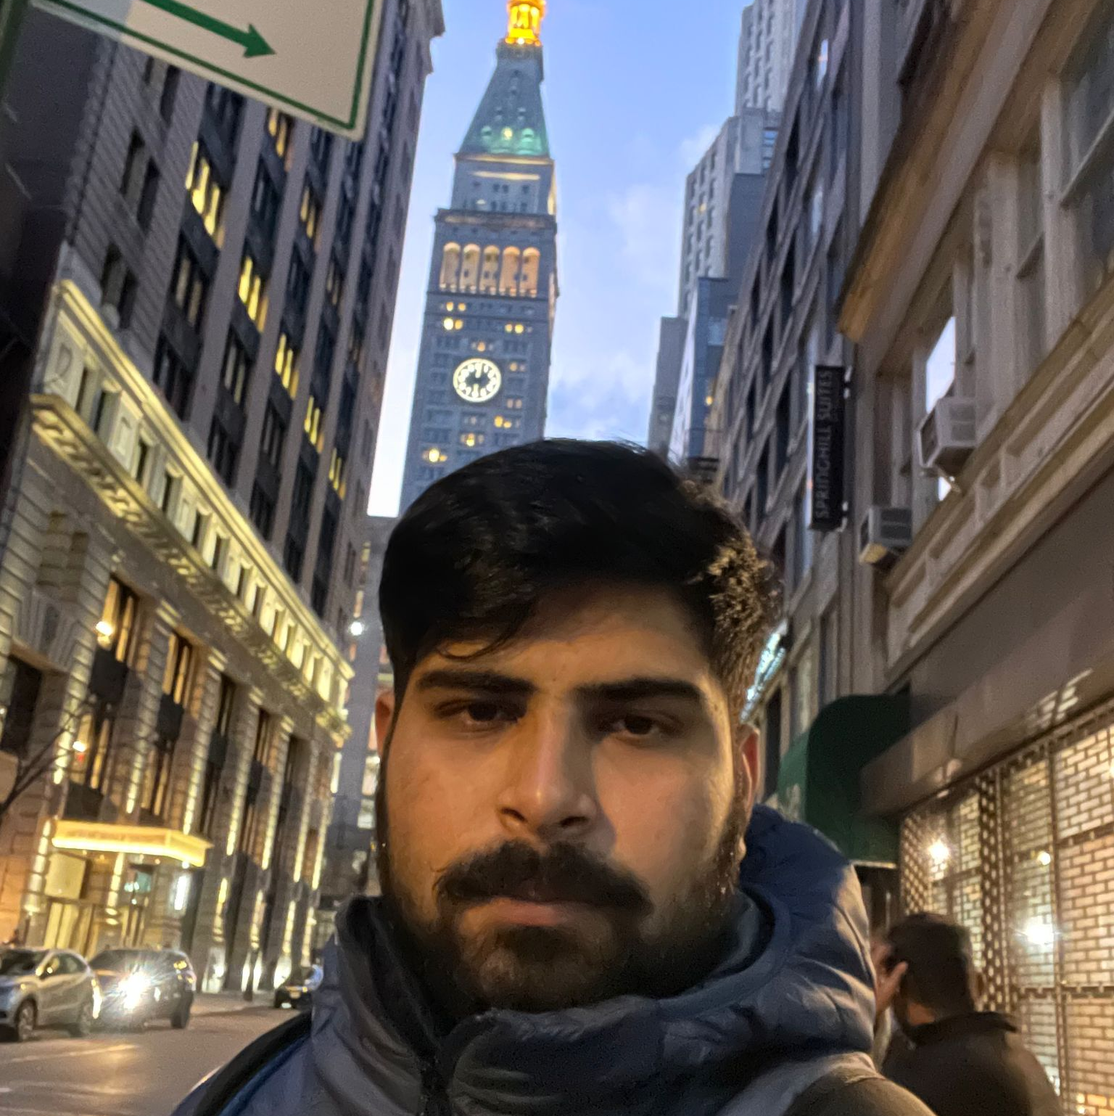

MEET OUR TEAM
SHIVANSH TOMAR
NIKHIL
JIGAR SHAH
QUALITY
ANALYST EGINEER
DEVELOPER
DEVELOPER

Slide 6
Improvements made from Professor Feedback
Feedback
Improvements
Add description to Jira section on Wiki Page.
Labels were missing in the Technology slide.
Use correct spellings and grammar in the presentation
Specify and add details in Product Backlog, User Stories and Acceptance criteria.
Consistent theme should be used.
Retrospective should be more specific.
Added description to Jira section on Wiki page
Added missing labels in the Technology slides.
Corrected spellings and used correct grammar in the presentation
Added details in Product Backlog, User Stories and Acceptance criteria.
Consistent theme is used all over the presentation.
Made efforts to make retrospectives more specific.

Slide 7
Problem Statement
Most hospitals are still facing several challenges with Hospital Management System because some of them are still using manual processes, while those who are using computerized method are also facing the challenge of adjusting to it. Like:
The high cost of software development and deployment.
Complex design in terms of User Interface and User Experience (UI/UX Design)
Fear of data security breach.
Difficulty in migrating from manual processes, because both staff and patients are used to the manual processes and so are unable to speedily cope with the new system.
Lack of IT-friendly medical personnel is also presenting several challenges.
A Huge influx of patients visiting government hospitals makes the process of migrating to automated processes highly difficult. They do not have the patience to wait for registration and data entry and often fail to understand the functioning of automated processes.

Slide 8
Project Description
Project Description
Project Name: | Cura HMS
Team Name: | Medical Maestros
Project Description: | CURA helps to automate routine tasks, optimize staff coordination, improve communication, distribute the workload, store different types of information, and provide financial and HR management. For patients who want to book an appointments, the CURA is a web app that provides a hassle-less to book an appointment with doctor, unlike the traditional way where we had to call or text and ask for doctor’s availability our cura app is a tool that collects data about patients, doctors, staff, hospital administrative details in one software.
Benefit Outcomes: | Patients can book appointments with particular Doctor according to their preferred date and time . Doctors can see the appointment list of patients and schedule his duties at hospital .
GitHub Wiki: | https://github.com/htmw/HMS/wiki

Slide 9
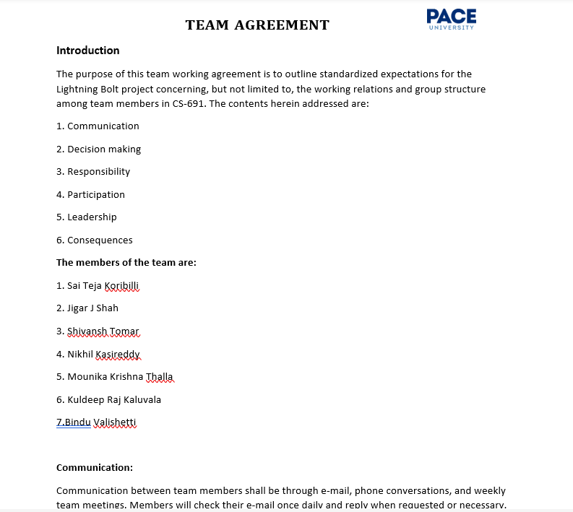
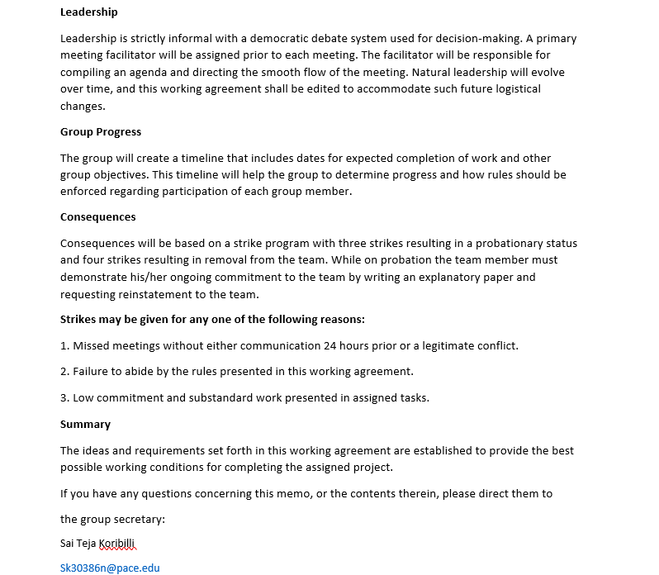
Team Working Agreement

Slide 10


Personas

Slide 11
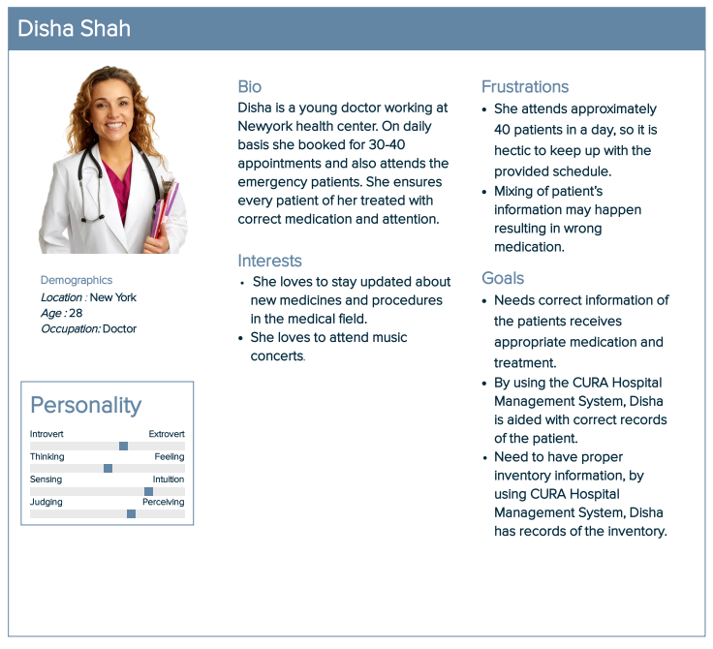
Persona 1

Slide 12
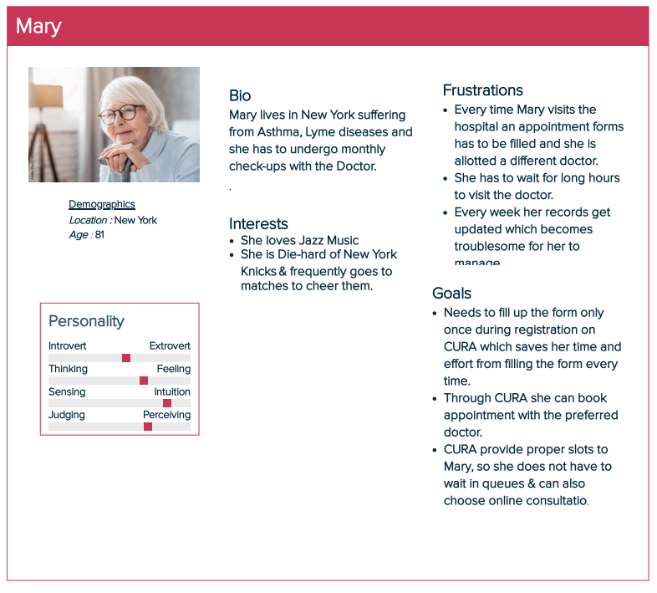
Persona 2

Slide 13
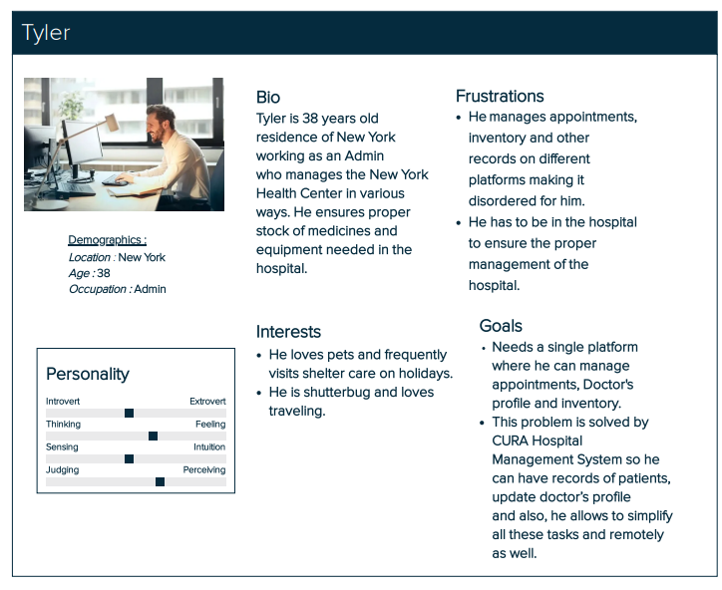
Persona 3

Slide 14

Minimal Viable Product (MVP)
Homepage
Registration
Login –Patient ,Doctor, Staff & Inventory
Scheduling duties
Appointment - booking & cancel

Slide 15









TECHNOLOGIES
FRONT END
Java Script
BACK END/ SERVER
DATABASE
TESTING
CUCUMBER
API
TOOLS

Slide 16
Algorithm
The proposed system has five modules for doctors, admin, pathologist, inventor and patients providing facilities of appointments schedules, payment, viewing online information, register on hospital website. The whole process of information sharing and processing in this systems is automated through Decision Tree ID3 algorithm
What is ID3 Algorithm ?
ID3 stands for Iterative Dichotomiser 3 and is named such because the algorithm iteratively (repeatedly) dichotomizes(divides) features into two or more groups at each step.
ID3 uses a top-down greedy approach to build a decision tree. In simple words, the top-down approach means that we start building the tree from the top and the greedy approach means that at each iteration we select the best feature at the present moment to create a node. Attempts to create the smallest possible decision tree.

Slide 17

Diagrams

Slide 18
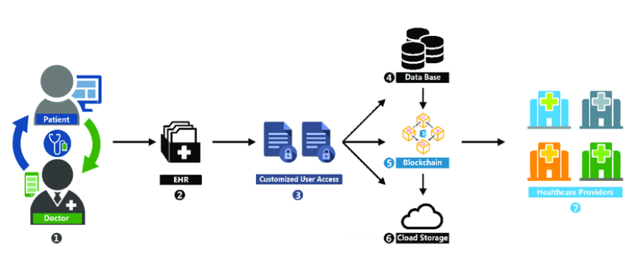

CONCEPTUL ARCHITECURE DIAGRAM

Slide 19
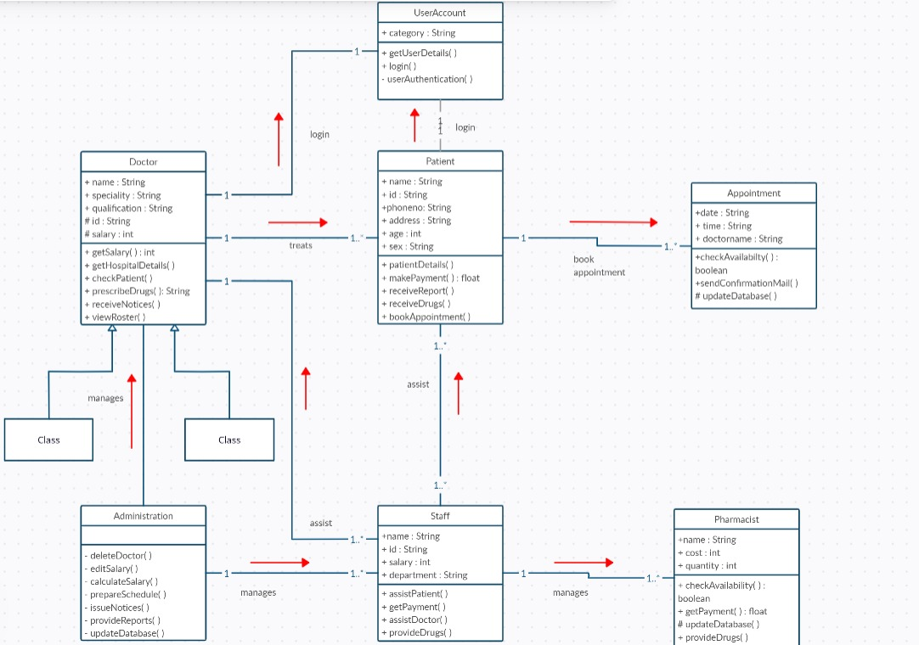
CLASS DIAGRAM
OF
CURA

Slide 20
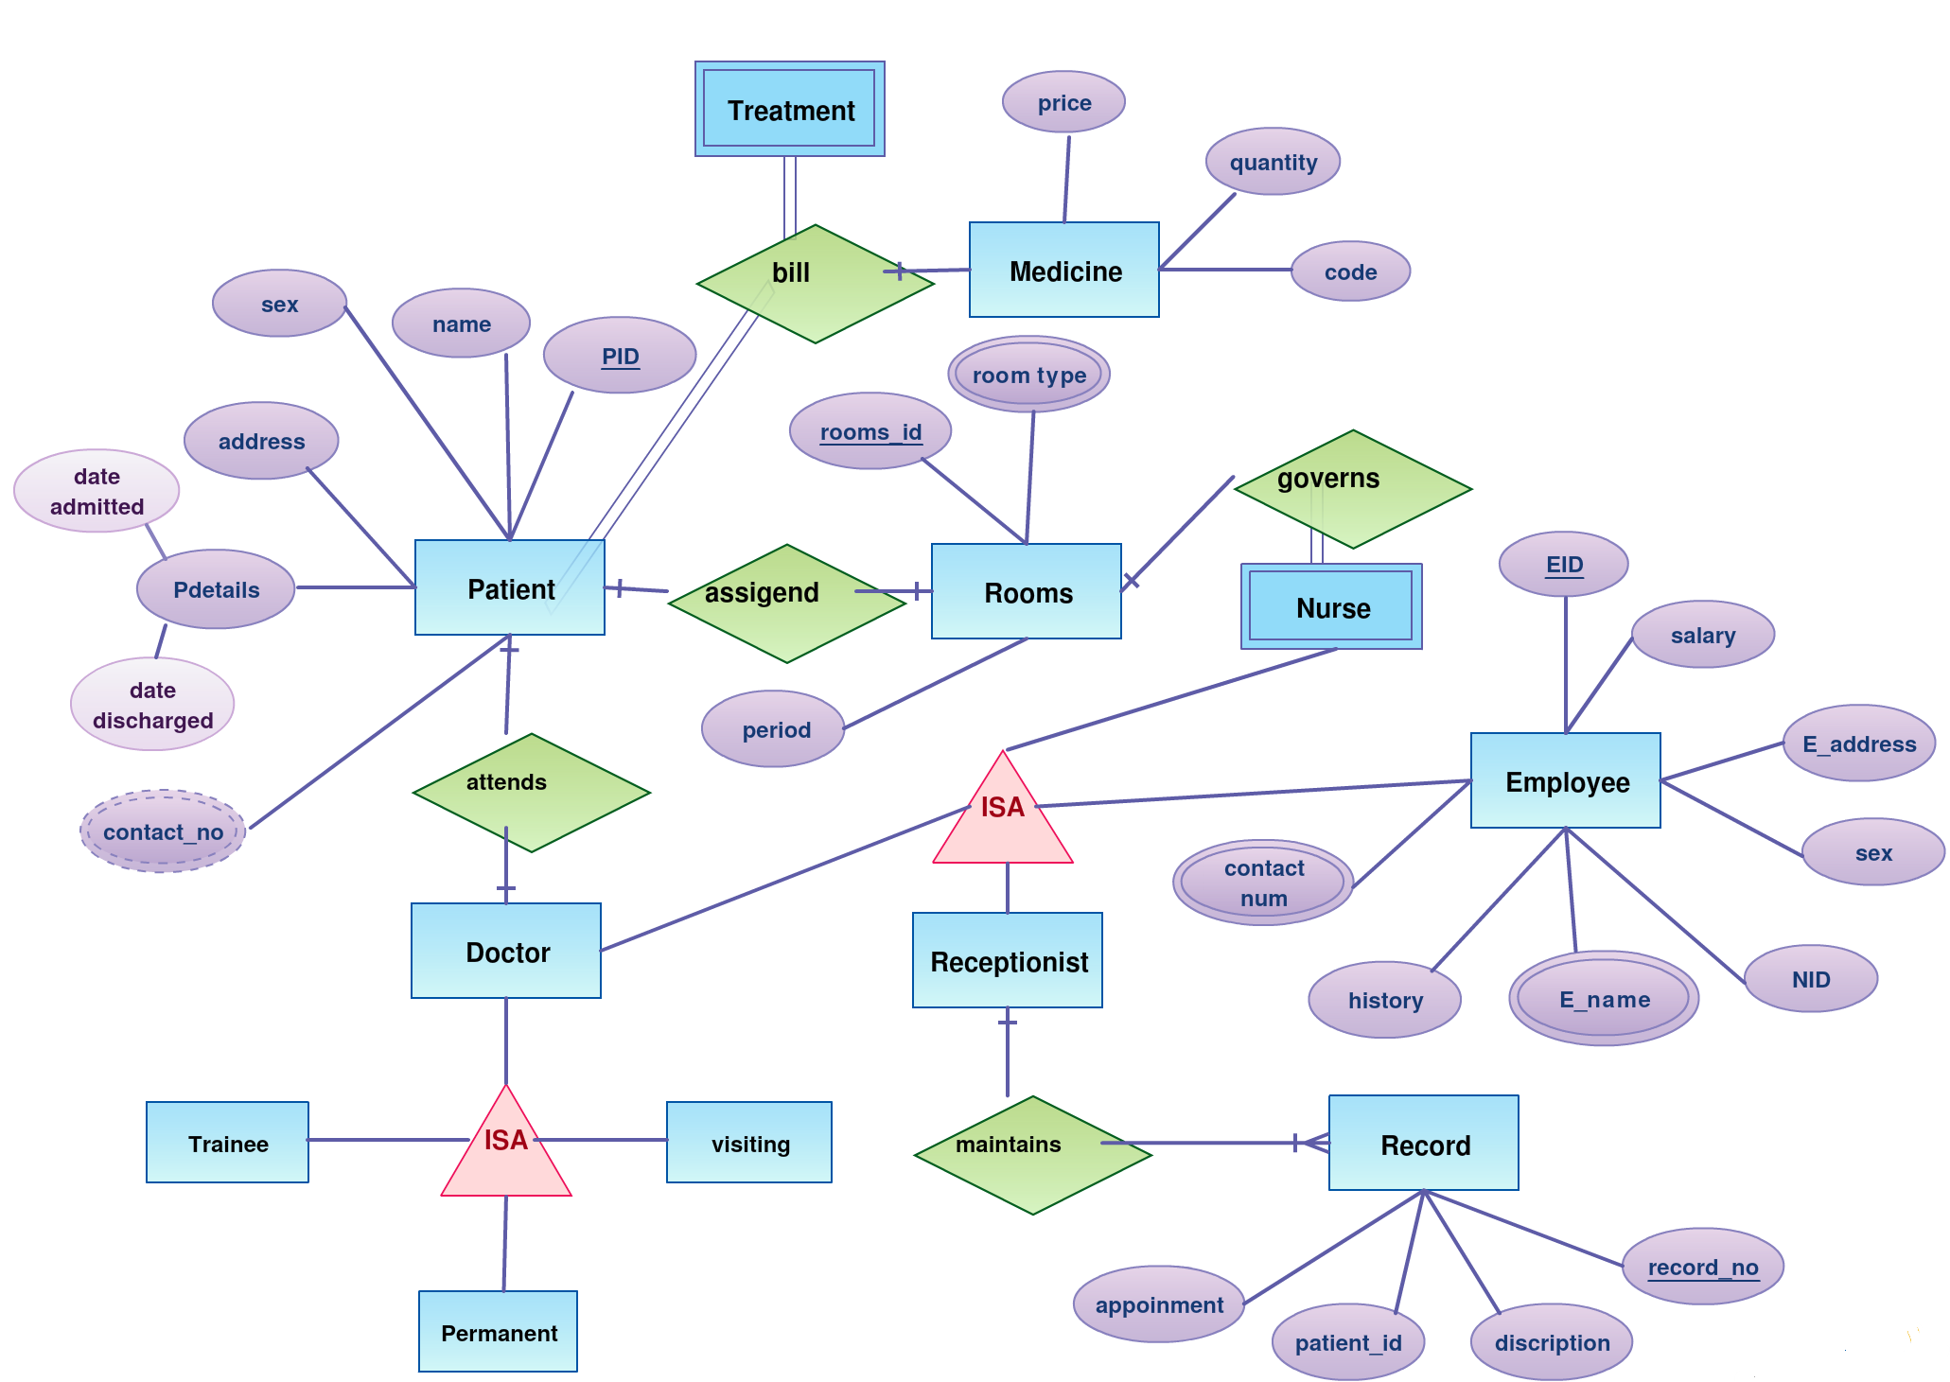
ER DIAGRAM

Slide 21
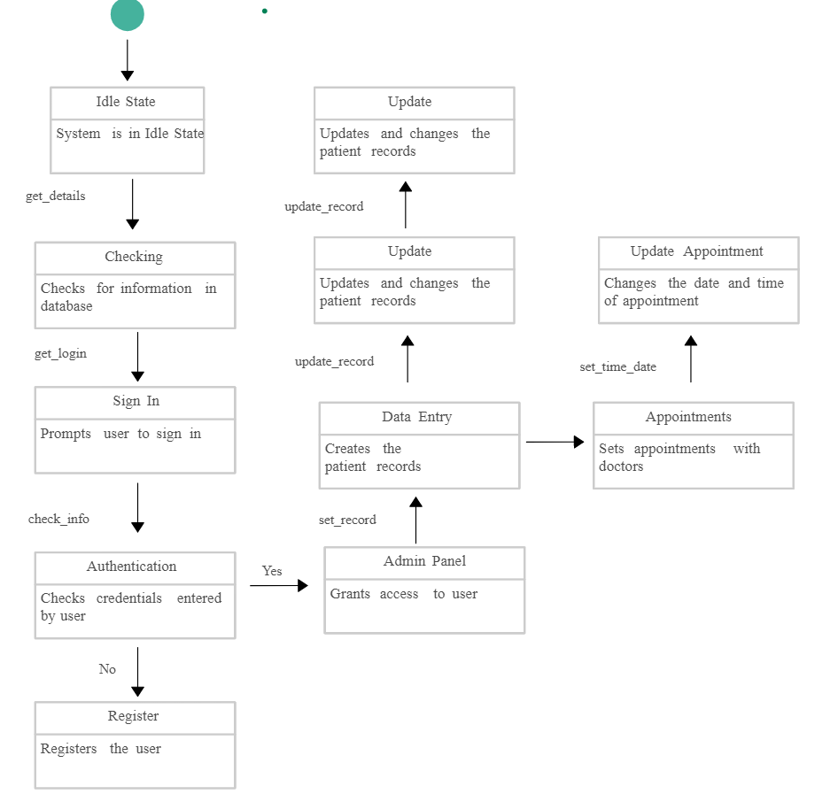
STATE DIAGRAM

Slide 22
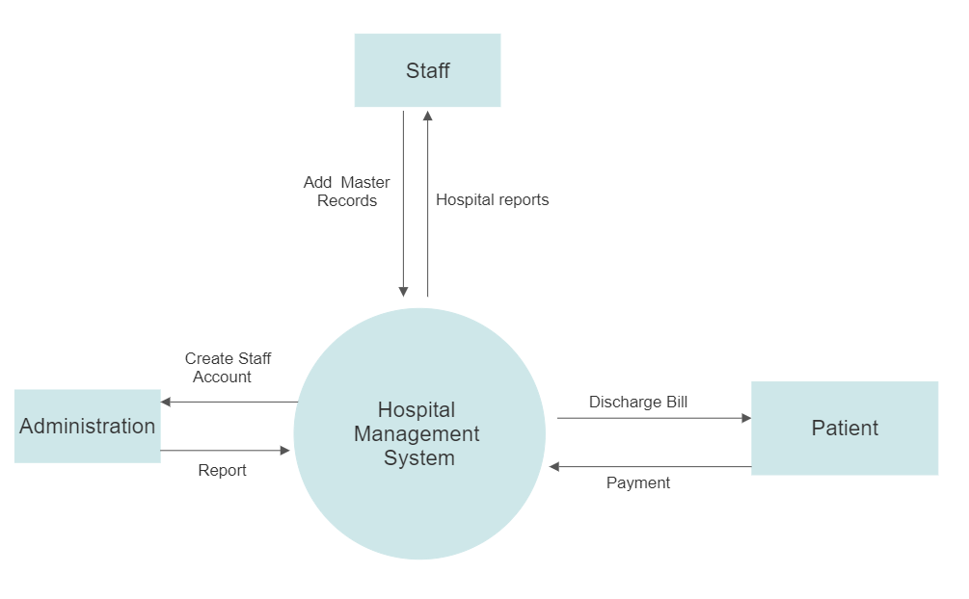
Dataflow
Diagram
Level 0

Slide 23
SPRINT 5 RECAP
Surfing through the options according to the role of the person using the application.
Updating the current profile status by uploading files.

Slide 24

PRODUCT BACKLOG

Slide 25
Product Backlog
Issue Type | ID | Summary | Status | Story Points | Priority
Story | CURA-29 | As a Doctor, I want to see my particulars/schedule/profile on the application so that I can plan my duties at hospital . | To-do | 3 | Medium
Story | CURA-30 | As a Patient, I want to confirm whether my appointment with the doctor is set up or no so that I can have an idea about my appointment with doctor. | Done | 4 | Medium
Story | CURA-31 | As a Patient, I want to submit my symptoms/previous history documents in the portal for assessment so that I may receive a accurate determination | Done | 4 | Medium
Story | CURA-32 | As an Inventor, I want to know whether the supplies are as per the requirement or no, so that I can re-stock them. | To-do | 3 | Medium
Story | CURA-33 | As a Pathologist, I want to know whether samples of the patient are correctly entered or no, so that there is no confusion with patient's details with others. | Done | 2 | Low
Story | CURA-34 | As an Admin, I want to navigate to doctor/staff/nurse section to check the log-in time so that I can verify whether every doctor/nurse/staff is attending the hospital on time. | To-do | 5 | High
Story | CURA-36 | As a Staff, I want to check room availability and manage rooms according to requirement so that it will be very helpful to doctors. | To-do | 2 | Low
Story | CURA-37 | As a Pathologist I want to upload patient test results in portal so that it will be easy to check report for Doctor before patient’s appointment . | Done | 4 | Low
Story | CURA-38 | As a Patient, I want to manages patient financial operations, including billing and insurance. | To-do | 3 | Medium
Story | CURA-39 | As a nurse, I want to see the prescriptions given by the doctor to the patients through the nurse portal. | To-do | 2 | Low

Slide 26
SPRINT 6 BACKLOG

Slide 27
Sprint 6 Backlog
Issue Type | Key | Summary | Story Points Estimate
Story | CURA – 31 | As a Patient, I want to submit my symptoms/previous history documents in the portal for assessment so that I may receive a accurate determination . . | 4
Story | CURA - 30 | As a Patient, I want to confirm whether my appointment with the doctor is set up or no so that I can have an idea about my appointment with doctor. | 4
Story | CURA - 33 | As a Pathologist, I want to know whether samples of the patient are correctly entered or no, so that there is no confusion with patient's details with others. | 3
Story | CURA-37 | As a Pathologist I want to upload patient test results in portal so that it will be easy to check report for Doctor before patient’s appointment . | 4

Slide 28
User Stories &Acceptance criteria

Slide 29
User Stories & Acceptance Criteria
User Story ID | Summary | Status
CURA-31 | As a Patient, I want to submit my symptoms/previous history documents in the portal for assessment so that I may receive a accurate determination | Done
 | Scenario : Patient wants to upload his previous history documents & symptoms Given I logged as Patient When I open the application and go to this page then see the browse option for uploading the documents and see the page to enter the details of my previous history & symptoms.
CURA-30 | As a Patient, I want to confirm whether my appointment with the doctor is set up or no so that I can have an idea about my appointment with doctor | Done
 | Scenario : Patient wants to check with his appointment details Given I logged as Patient When I open the application and go to this page then see my appointment details with the doctor and I plan accordingly.
CURA-33 | As a Pathologist, I want to know whether samples of the patient are correctly entered or no, so that there is no confusion with patient's details with others. | Done
 | Scenario : Pathologist wants to check patient's samples Given I am in a role of logged-in Pathologist When I open web-application and go to this page then verify the patient's samples entered correctly or not
CURA-37 | As a Pathologist I want to upload patient test results in portal so that it will be easy to check report for Doctor before patient’s appointment . | Done
 | Scenario : Pathologist wants to upload test reports Given I'm in a role of Pathology or logged-in pathology When I open the web application then see the reports tab and click on it and upload test results in portal.

Slide 30
Test Cases
Test ID | User Story ID | Test Case | Current State | Test Data | Steps To Follow | Expected Results
TS-30 | CURA – 30 | Loading Appointment Details Page | User Login Into The Application As a Patient | Email:- aabc@cura.com Pswd:- abc | Patients -> Appointments | User should be able to see his appoinment details
TS-31 | CURA-31 | Uploading Patient Details Page | User Login Into The Application As a Patient | Email:- aabc@cura.com Pswd:- abc | Patients -> Symptoms | User should be able to upload His previous Documents and symptoms details
TS-32 | CURA-33 | Loading Patient Test Sample Data Details Page | User Login Into The Application As a Pathologist | Email:- aabc@cura.com Pswd:- abc | Pathologist -> Sample Test Data | User should be able to see all patients test data for examining
TS-33 | CURA-37 | Uploading Patient Test Results Data | User Login Into The Application As a Pathologist | Email:- aabc@cura.com Pwd:- abc | Pathologist -> Test Results Data | User should be able to Upload patient test results before doctors appointment

Slide 31
Stories Completed and Stories Not Complete
User Story Id | Summary | Story Points Estimate | Status
CURA – 31 | As a Patient, I want to submit my symptoms/previous history documents in the portal for assessment so that I may receive a accurate determination . . | 4 | Completed
CURA - 30 | As a Patient, I want to confirm whether my appointment with the doctor is set up or no so that I can have an idea about my appointment with doctor. | 4 | Completed
CURA - 33 | As a Pathologist, I want to know whether samples of the patient are correctly entered or no, so that there is no confusion with patient's details with others. | 3 | Completed
CURA-37 | As a Pathologist I want to upload patient test results in portal so that it will be easy to check report for Doctor before patient’s appointment . | 4 | Completed

Slide 32

METRICS

Slide 33
Team Velocity

Slide 34
Burndown chart

Slide 35
COMMITTED/ COMPLETED
RATIO

Slide 36

Retrospective

Slide 37
What went well??
Team productivity is improved.
Improved communication among the team members.
Time Management is efficient.
Each team member understood their role and performed well in their allocated tasks

Slide 38
What didn’t go well??
We have not reached to desired UI of the application.
Bugs raised at the unit testing were delayed in handling.
Took more than expected time to complete the User stories.
Employ more precise methods to determine the magnitude of the story.

Slide 39
What needs improvement?
Time management needs to be effective.
Should be able to articulate the User Stories clearly.
Knowledge-sharing time into each sprint.
Better testing should be done to prevent bugs.

Slide 40
Stories Planned and Committed for Sprint 7
User Story Id | Summary | Status
CURA-29 | As a Doctor, I want to see my particulars/schedule/profile on the application so that I can plan my duties at hospital . | To-do
CURA-34 | As an Admin, I want to navigate to doctor/staff/nurse section to check the log-in time so that I can verify whether every doctor/nurse/staff is attending the hospital on time. | To-do
CURA-39 | As a nurse, I want to see the prescriptions given by the doctor to the patients through the nurse portal. | To-do
CURA-32 | As an Inventor, I want to know whether the supplies are as per the requirement or no, so that I can re-stock them. | To-do

Slide 41

Application Screenshots

Slide 42
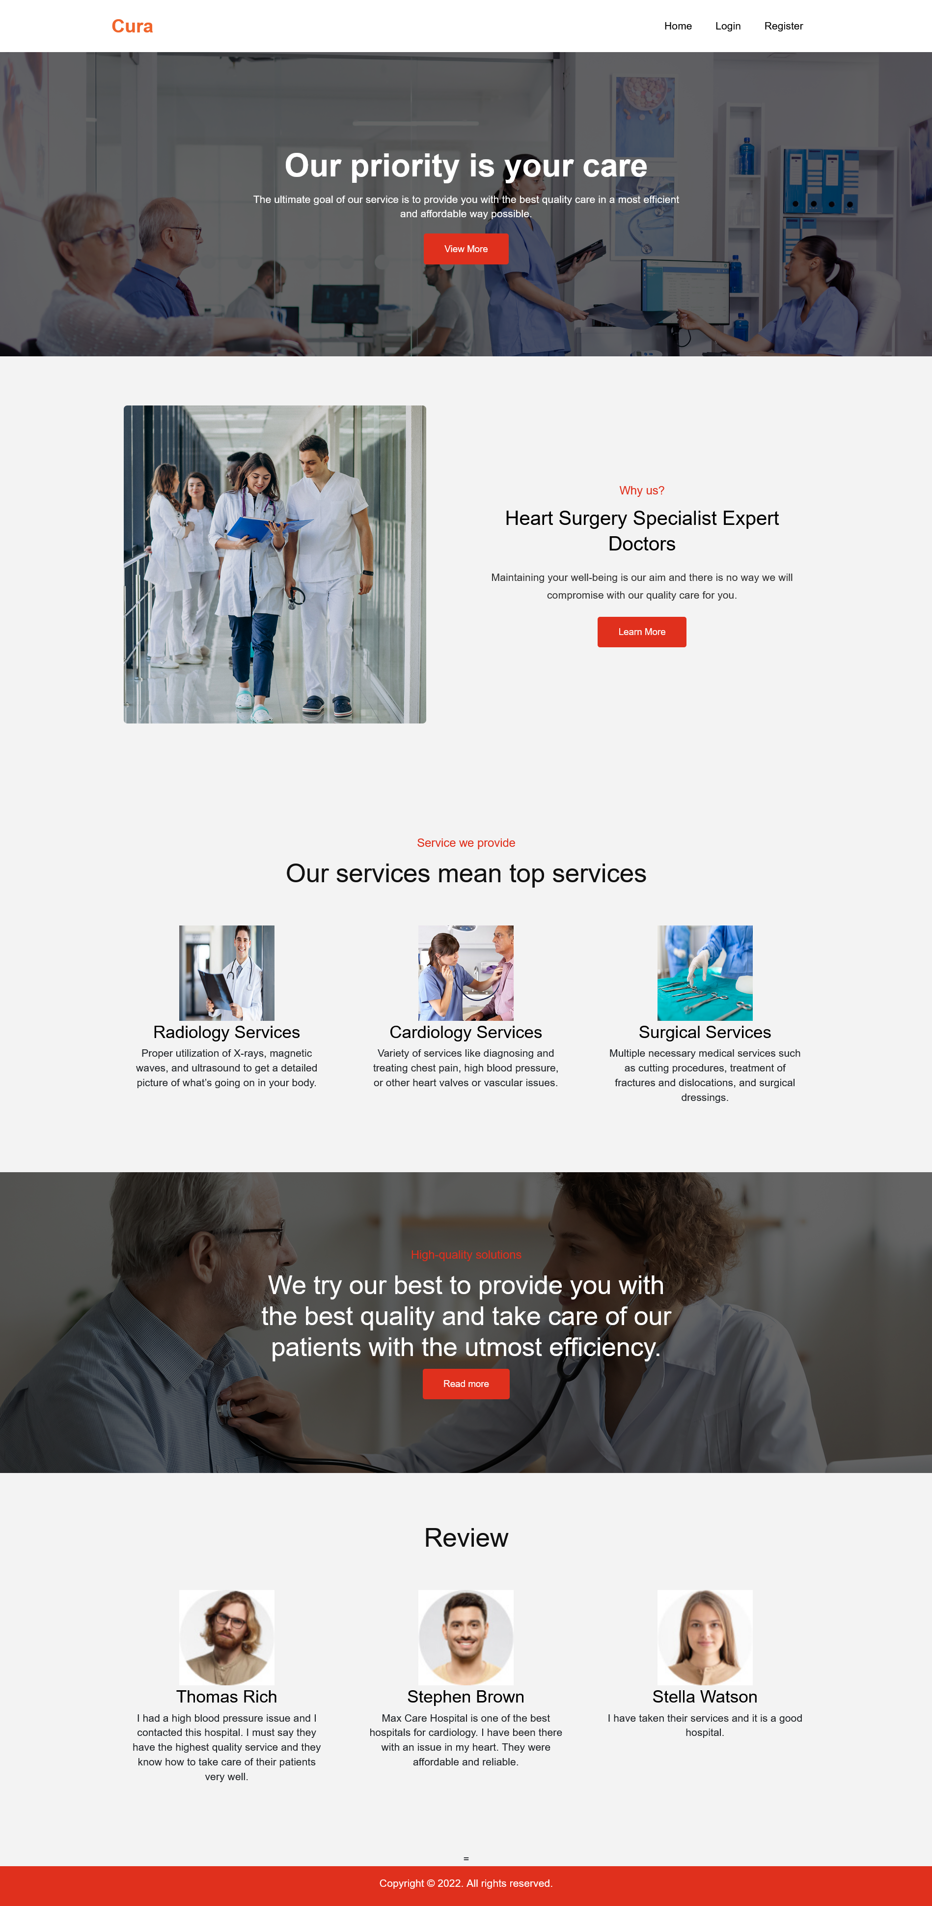
Home Page

Slide 43
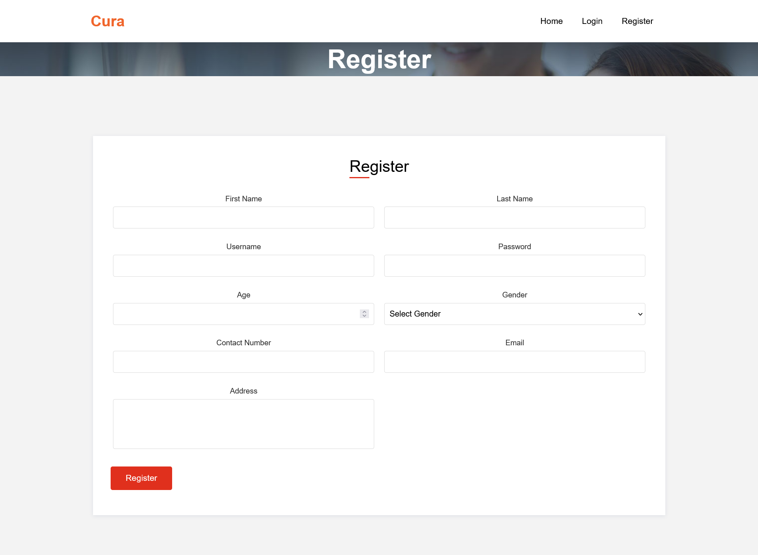
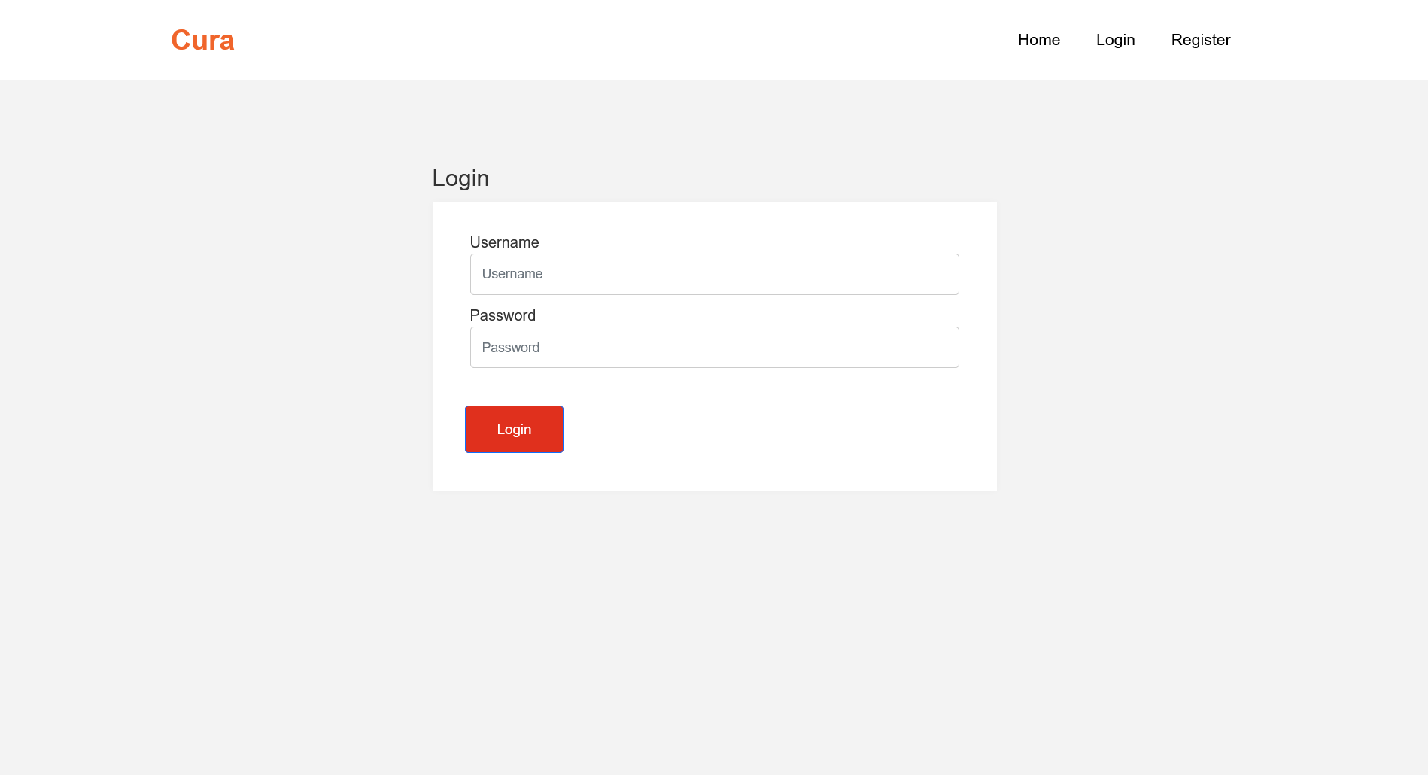
Register & Login Screen

Slide 44
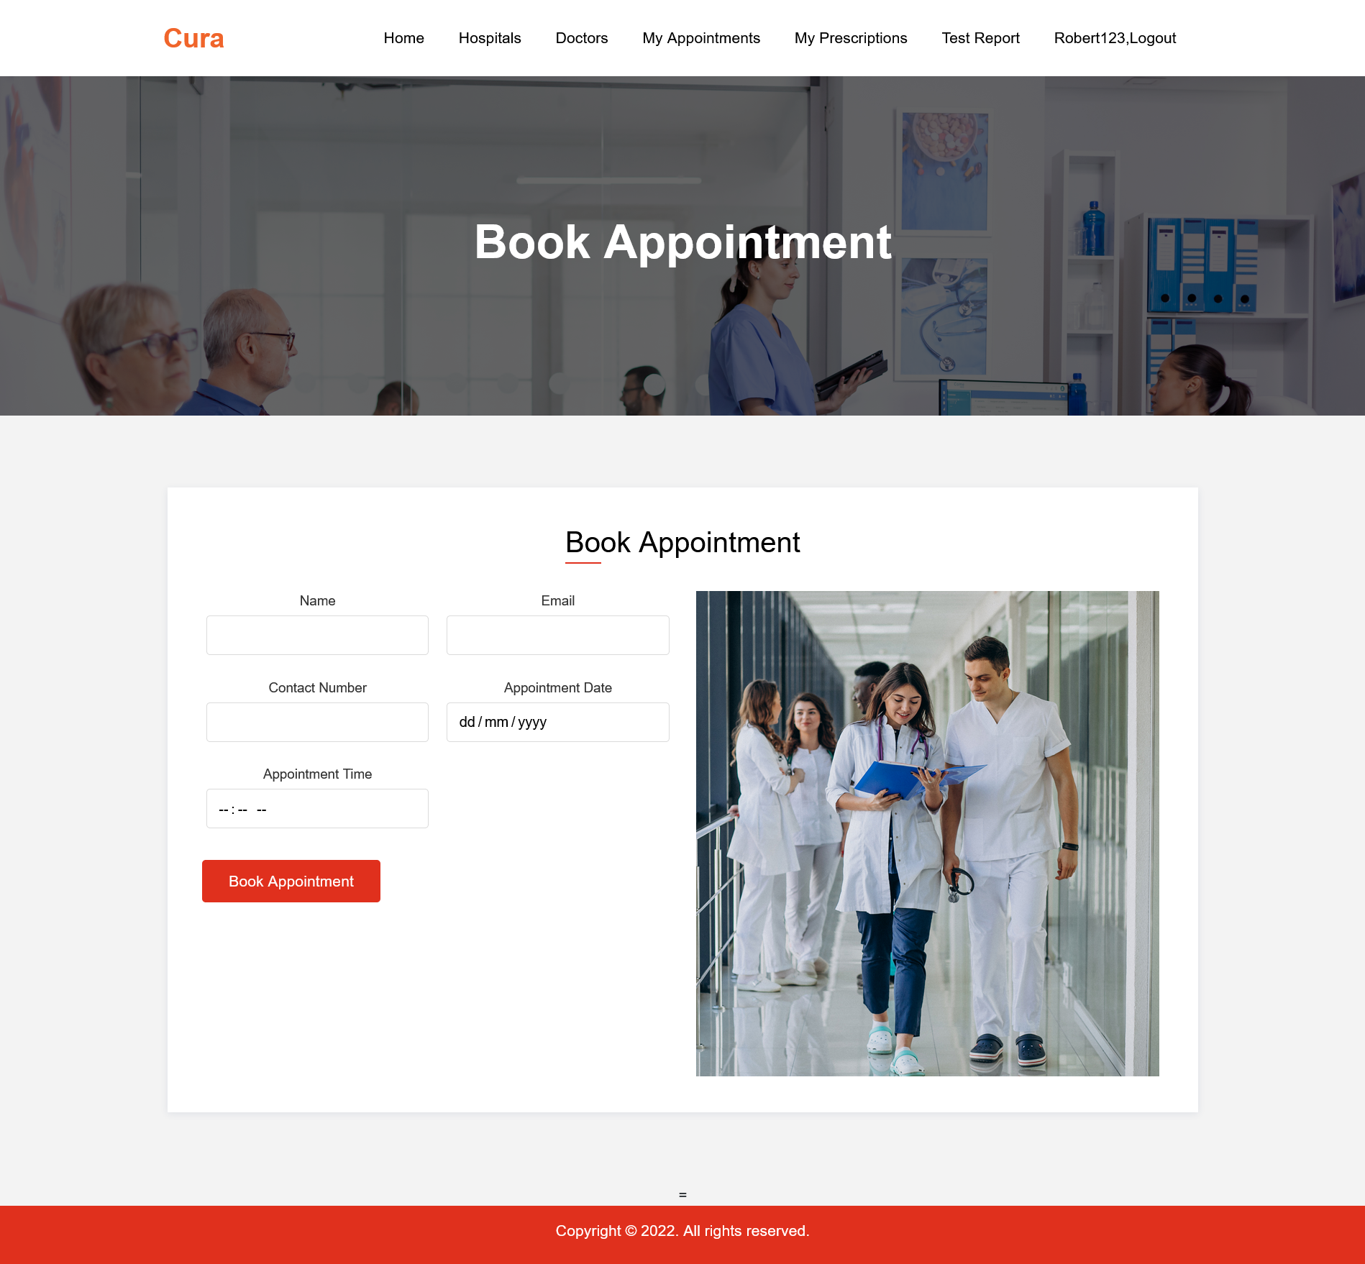
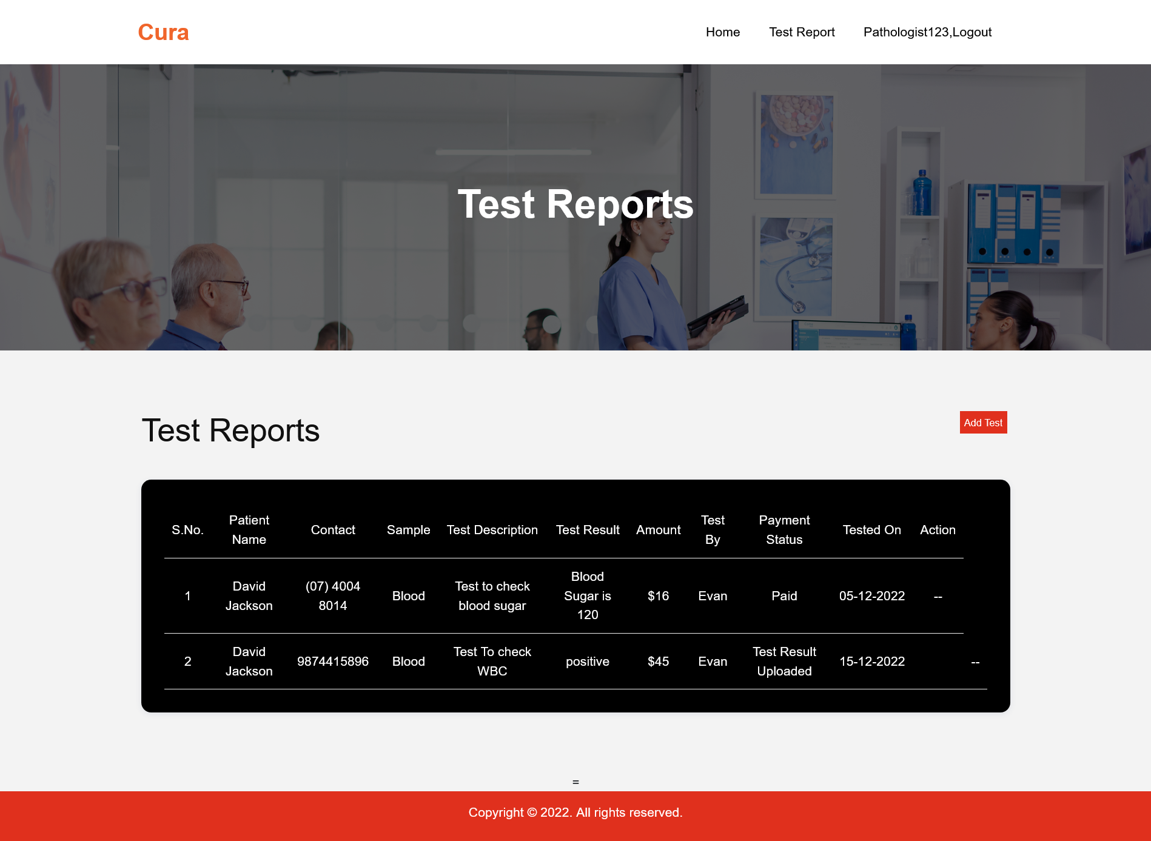
Appointments Screen

Slide 45

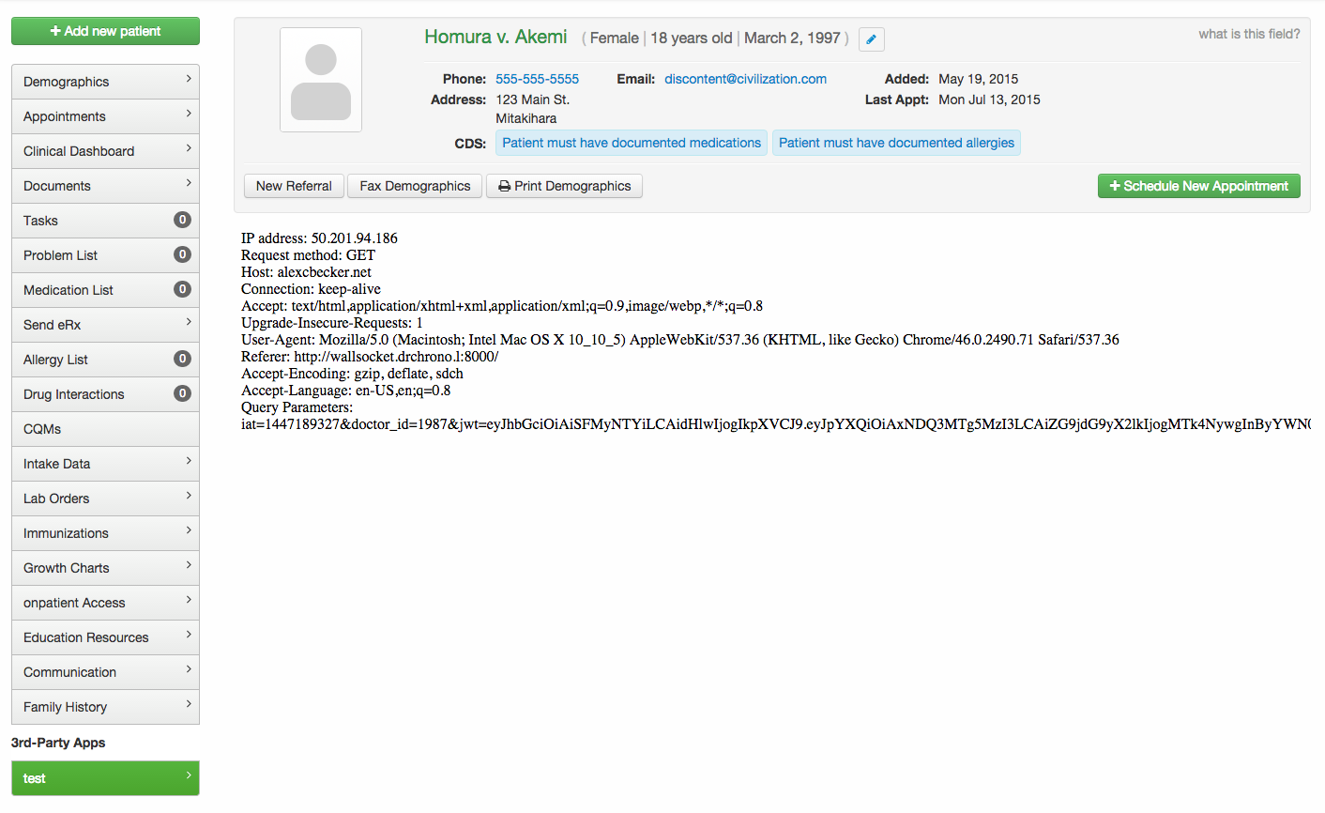

Api used

Slide 46


GITHUB LINK
https://github.com/htmw/HMS/wiki

Slide 47

THANK YOU
Sai Teja Koribilli
Jigar Shah
Mounika Thalla
Kuldeep Raj
Bindu Valishetti
Nikhil
Shivansh Tomar

